Slide 1
Managing Human Resources
Dr. Jayashree Mahesh,
Department of Management, BITS Pilani.

Slide 2
Learning Outcomes
10.1 The Human Resource Management Process
  Explain why the HRM process is important.
  Discuss the environmental factors that most directly affect the HRM process.
10.2 Identifying and Selecting Competent Employees
  Define job analysis, job description, and job specification.
  Discuss the major sources of potential job candidates.
  Describe the different selection devices and which works best for different jobs.
  Explain why a realistic job preview is important.

Slide 3
Learning Outcomes
10.3 Providing Employees with Needed Skills
and Knowledge
  Explain why orientation is so important.
  Describe the different types of training and how that training can be provided.
10.4 Retaining Competent, High Performing
Employees
  Describe the different performance appraisal methods.
  Discuss the factors that influence employee compensation and benefits.
  Describe skill-based and variable pay systems.
Copyright © 2010 Pearson Education, Inc. Publishing as Prentice Hall
10–<number>

Slide 4
Learning Outcomes
10.5 Contemporary Issues in Managing Human
Resources
  Explain how managers can manage downsizing.
  Discuss how managers can manage workforce diversity.
  Explain what sexual harassment is and what managers need to know about it.
  Describe how organizations are dealing with work-life balance issues.
  Discuss how organizations are controlling HR costs.
Copyright © 2010 Pearson Education, Inc. Publishing as Prentice Hall
10–<number>

Slide 5
The Importance of Human Resource Management (HRM)
As a significant source of competitive advantage
  People-oriented HR creates superior shareholder value
As an important strategic tool
  Achieve competitive success through people by treating employees as partners
To improve organizational performance
  High performance work practices lead to both high individual and high organizational performance.
Copyright © 2010 Pearson Education, Inc. Publishing as Prentice Hall
10–<number>

Slide 6
Exhibit 10–1 Examples of High-Performance Work Practices
Self-managed teams
Decentralized decision making
Training programs to develop knowledge, skills, and abilities
Flexible job assignments
Open communication
Performance-based compensation
Staffing based on person–job and person–organization fit
Source: Based on W. R. Evans and W. D. Davis, “High-Performance Work Systems and Organizational Performance: The Mediating Role of Internal Social Structure,” Journal of Management, October 2005, p. 760.
Copyright © 2010 Pearson Education, Inc. Publishing as Prentice Hall
10–<number>

Slide 7
The HRM Process
Functions of the HRM Process
  Ensuring that competent employees are identified and selected.
  Providing employees with up-to-date knowledge and skills to do their jobs.
  Ensuring that the organization retains competent and high-performing employees.
Copyright © 2010 Pearson Education, Inc. Publishing as Prentice Hall
10–<number>

Slide 8
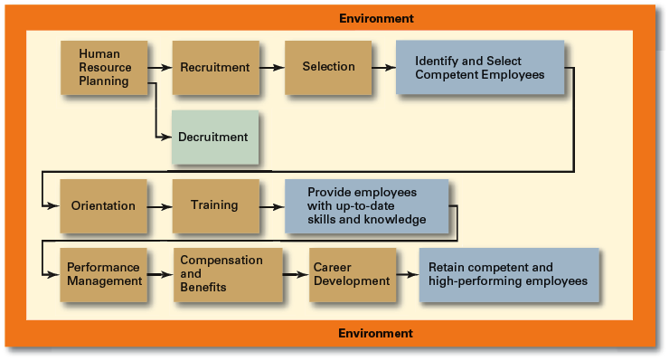

Exhibit 10–2 Human Resource Management Process
Copyright © 2010 Pearson Education, Inc. Publishing as Prentice Hall
10–<number>

Slide 9
Environmental Factors Affecting HRM
Employee Labor Unions
  Organizations that represent workers and seek to protect their interests through collective bargaining.
    Collective bargaining agreement
      A contractual agreement between a firm and a union elected to represent a bargaining unit of employees of the firm in bargaining for wage, hours, and working conditions.
Governmental Laws and Regulations
  Limit managerial discretion in hiring, promoting, and discharging employees.
    Affirmative Action: Organizational programs that enhance the status of members of protected groups.
Copyright © 2010 Pearson Education, Inc. Publishing as Prentice Hall
10–<number>

Slide 10
Exhibit 10–3 Major U.S. Federal Laws and Regulations
Related to HRM
1963 Equal Pay Act
1964 Civil Rights Act, Title VII (amended in 1972)
1967 Age Discrimination in Employment Act
1973 Vocational Rehabilitation Act
1974 Privacy Act
1978 Mandatory Retirement Act
1986 Immigration Reform and Control Act
1988 Worker Adjustment and Retraining Notification Act
1990 Americans with Disabilities Act
1991 Civil Rights Act of 1991
1993 Family and Medical Leave Act of 1993
1996 Health Insurance Portability and Accountability Act of 1996
2004 FairPay Overtime Initiative
Copyright © 2010 Pearson Education, Inc. Publishing as Prentice Hall
10–<number>

Slide 11
Managing Human Resources
Human Resource (HR) Planning
  The process by which managers ensure that they have the right number and kinds of people in the right places, and at the right times, who are capable of effectively and efficiently performing their tasks.
  Helps avoid sudden talent shortages and surpluses.
  Steps in HR planning:
    Assessing current human resources
    Assessing future needs for human resources
Copyright © 2010 Pearson Education, Inc. Publishing as Prentice Hall
10–<number>

Slide 12
Current Assessment
Human Resource Inventory
  A review of the current make-up of the organization’s current resource status.
  Job Analysis
    An assessment that defines a job and the behaviors necessary to perform the job.
    Requires conducting interviews, engaging in direct observation, and collecting the self-reports of employees and their managers.
Copyright © 2010 Pearson Education, Inc. Publishing as Prentice Hall
10–<number>

Slide 13
Current Assessment (cont’d)
Job Description
  A written statement that describes a job.
Job Specification
  A written statement of the minimum qualifications that a person must possess to perform a given job successfully.
Copyright © 2010 Pearson Education, Inc. Publishing as Prentice Hall
10–<number>

Slide 14
Meeting Future Human Resource Needs
Demand for Employees
Factors Affecting Staffing
Strategic Goals
Forecast demand for products and services
Availability of knowledge, skills, and abilities
Copyright © 2010 Pearson Education, Inc. Publishing as Prentice Hall
10–<number>

Slide 15
Recruitment and Decruitment
Recruitment
  The process of locating, identifying, and attracting capable applicants to an organization
Decruitment
  The process of reducing a surplus of employees in the workforce of an organization
Online Recruiting
  Recruitment of employees through the Internet
    Organizational Web sites
    Online recruiters
Copyright © 2010 Pearson Education, Inc. Publishing as Prentice Hall
10–<number>

Slide 16
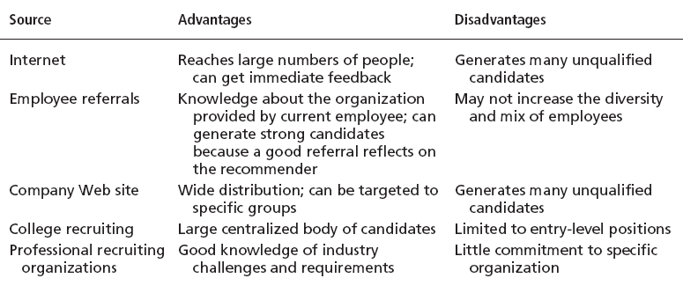
Exhibit 10–4 Major Sources of Potential Job
Candidates
Copyright © 2010 Pearson Education, Inc. Publishing as Prentice Hall
10–<number>

Slide 17
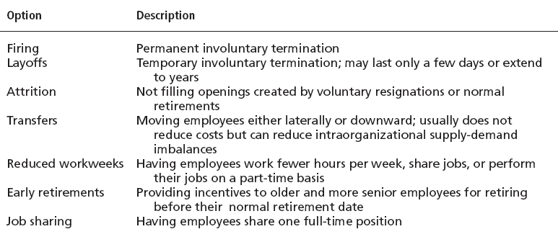
Exhibit 10–5 Decruitment Options
Copyright © 2010 Pearson Education, Inc. Publishing as Prentice Hall
10–<number>

Slide 18
Selection
Selection Process
  The process of screening job applicants to ensure that the most appropriate candidates are hired.
What is Selection?
  An exercise in predicting which applicants, if hired, will be (or will not be) successful in performing well on the criteria the organization uses to evaluate performance.
  Selection errors:
    Reject errors for potentially successful applicants
    Accept errors for ultimately poor performers
Copyright © 2010 Pearson Education, Inc. Publishing as Prentice Hall
10–<number>

Slide 19
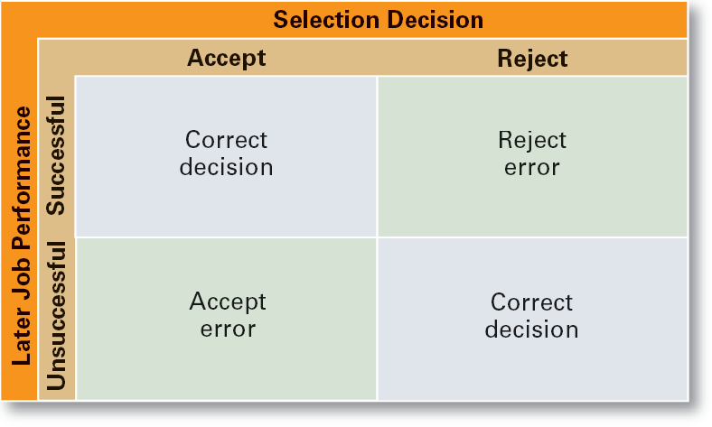
Exhibit 10–6 Selection Decision Outcomes
Copyright © 2010 Pearson Education, Inc. Publishing as Prentice Hall
10–<number>

Slide 20
Validity and Reliability
Validity (of Prediction)
  A proven relationship between the selection device used and some relevant criterion for successful performance in an organization.
Reliability (of Prediction)
  The degree of consistency with which a selection device measures the same thing.
    Individual test scores obtained with a selection device are consistent over multiple testing instances.
Copyright © 2010 Pearson Education, Inc. Publishing as Prentice Hall
10–<number>

Slide 21

Exhibit 10–7 Selection Tools
Application Forms
Written Tests
Performance Simulations Tests
Interviews
Background Investigations
Physical Examinations
Copyright © 2010 Pearson Education, Inc. Publishing as Prentice Hall
10–<number>

Slide 22
Application Forms
Strengths and weaknesses:
  Almost universally used
  Relevant biographical data and facts that can be verified
  Can predict job performance
  Weighted-item applications are difficult and expensive to create and maintain
Copyright © 2010 Pearson Education, Inc. Publishing as Prentice Hall
10–<number>

Slide 23
Written Tests
Types of Tests
  Intelligence: how smart are you?
  Aptitude: can you learn to do it?
  Attitude: how do you feel about it?
  Ability: can you do it now?
  Interest: do you want to do it?
Legal Challenges to Tests
  Lack of job-relatedness of test items or interview questions to job requirements
  Discrimination in equal employment opportunity against members of protected classes
Copyright © 2010 Pearson Education, Inc. Publishing as Prentice Hall
10–<number>

Slide 24
Performance Simulation Tests
Testing an applicant’s ability to perform actual job behaviors, use required skills, and demonstrate specific knowledge of the job.
  Work sampling
    Requiring applicants to actually perform a task or set of tasks that are central to successful job performance.
  Assessment centers
    Dedicated facilities in which job candidates undergo a series of performance simulation tests to evaluate their managerial potential.
Copyright © 2010 Pearson Education, Inc. Publishing as Prentice Hall
10–<number>

Slide 25
Other Selection Approaches
Interviews
  Although used almost universally, managers need to approach interviews carefully.
Background Investigations
  Verification of application data
  Reference checks:
    Lack validity because self-selection of references ensures only positive outcomes.
Physical Examinations
  Useful for physical requirements and for insurance purposes related to pre-existing conditions.
Copyright © 2010 Pearson Education, Inc. Publishing as Prentice Hall
10–<number>

Slide 26
Other Selection Approaches (cont’d)
Realistic Job Preview (RJP)
  The process of relating to an applicant both the positive and the negative aspects of the job.
    Encourages mismatched applicants to withdraw.
    Aligns successful applicants’ expectations with actual job conditions, reducing turnover.
Copyright © 2010 Pearson Education, Inc. Publishing as Prentice Hall
10–<number>

Slide 27
Employee Needed Skills and Knowledge
Orientation
  Education that introduces a new employee to his or her job and the organization.
    Work unit orientation
    Organization orientation
Employee Training
  Types of training
  Training Methods
Copyright © 2010 Pearson Education, Inc. Publishing as Prentice Hall
10–<number>

Slide 28
Exhibit 10–8 Types of Training
Type | Includes
General | Communication skills, computer systems application and programming, customer service, executive development, management skills and development, personal growth, sales, supervisory skills, and technological skills and knowledge
Specific | Basic life/work skills, creativity, customer education, diversity/cultural awareness, remedial writing, managing change, leadership, product knowledge, public speaking/presentation skills, safety, ethics, sexual harassment, team building, wellness, and others
Source: Based on “2005 Industry Report—Types of Training,” Training, December 2005, p. 22.
Copyright © 2010 Pearson Education, Inc. Publishing as Prentice Hall
10–<number>

Slide 29
Exhibit 10–9 Training Methods
Traditional
Training Methods
  On-the-job
  Job rotation
  Mentoring and coaching
  Experiential exercises
  Workbooks/manuals
  Classroom lectures
Technology-Based Training Methods
  CD-ROM/DVD/videotapes/ audiotapes
  Videoconferencing/ teleconferencing/
  satellite TV
  E-learning
Copyright © 2010 Pearson Education, Inc. Publishing as Prentice Hall
10–<number>

Slide 30

Employee Performance Management
Performance Management System
  A process of establishing performance standards and appraising employee performance.
Copyright © 2010 Pearson Education, Inc. Publishing as Prentice Hall
10–<number>

Slide 31
Exhibit 10–10 Advantages and Disadvantages of Performance
Appraisal Methods
Method | Advantage | Disadvantage
Written essays | Simple to use | More a measure of evaluator’s writing ability than of employee’s actual performance
Critical incidents | Rich examples; behaviorally based | Time-consuming; lack quantification
Graphic rating scales | Provide quantitative data; less time-consuming than others | Do not provide depth of job behavior assessed
BARS | Focus on specific and measurable job behaviors | Time-consuming; difficult to develop
Multiperson comparisons | Compares employees with one another | Unwieldy with large number of employees; legal concerns
MBO | Focuses on end goals; results oriented | Time-consuming
360-degree appraisals | Thorough | Time-consuming
Copyright © 2010 Pearson Education, Inc. Publishing as Prentice Hall
10–<number>

Slide 32
Compensation and Benefits
Benefits of a Fair, Effective, and Appropriate Compensation System
  Helps attract and retain high-performance employees
  Impacts the strategic performance of the firm
Types of Compensation
  Base wage or salary
  Wage and salary add-ons
  Incentive payments
  Skill-based pay
  Variable pay
Copyright © 2010 Pearson Education, Inc. Publishing as Prentice Hall
10–<number>

Slide 33
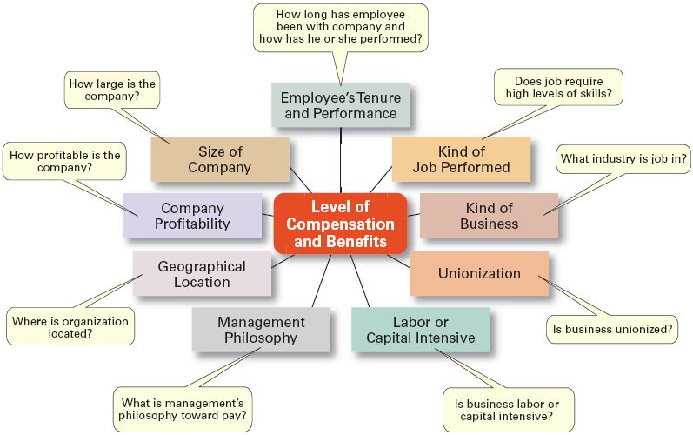
Exhibit 10–11 Factors That Influence Compensation and Benefits
Sources: Based on R.I. Henderson, Compensation Management, 6th ed. (Upper Saddle River, NJ: Prentice Hall, 1994), pp. 3–24; and A. Murray, “Mom, Apple Pie, and Small Business,” Wall Street Journal, August 15, 1994, p. A1
Copyright © 2010 Pearson Education, Inc. Publishing as Prentice Hall
10–<number>

Slide 34
Contemporary Issues in Managing Human Resources
Managing Downsizing
  The planned elimination of jobs in an organization
    Provide open and honest communication.
    Provide assistance to employees being downsized.
    Reassure and counseling to surviving employees.
Managing Workforce Diversity
  Widen the recruitment net for diversity
  Ensure selection without discrimination
  Provide orientation and training that is effective
Copyright © 2010 Pearson Education, Inc. Publishing as Prentice Hall
10–<number>

Slide 35
Exhibit 10–12 Tips for Managing Downsizing
• Communicate openly and honestly:
  ° Inform those being let go as soon as possible
  ° Tell surviving employees the new goals and expectations
° Explain impact of layoffs
• Follow any laws regulating severance pay or benefits
• Provide support/counseling for surviving employees
• Reassign roles according to individuals’ talents and backgrounds
• Focus on boosting morale:
  ° Offer individualized reassurance
  ° Continue to communicate, especially one-on-one
  ° Remain involved and available
Copyright © 2010 Pearson Education, Inc. Publishing as Prentice Hall
10–<number>

Slide 36
Current Issues in HRM (cont’d)
Sexual Harassment
  An unwanted activity of a sexual nature that affects an individual’s employment.
    Unwanted sexual advances, requests for sexual favors, and other verbal or physical conduct of a sexual nature when submission or rejection of this conduct explicitly or implicitly affects an individual’s employment.
  An offensive or hostile environment
    An environment in which a person is affected by elements of a sexual nature.
Workplace Romances
  Potential liability for harassment
Copyright © 2010 Pearson Education, Inc. Publishing as Prentice Hall
10–<number>

Slide 37
Current Issues in HRM (cont’d)
Work-Life Balance
  Employees have personal lives that they don’t leave behind when they come to work.
  Organizations have become more attuned to their employees by offering family-friendly benefits:
    On-site child care
    Summer day camps
    Flextime
    Job sharing
    Leave for personal matters
    Flexible job hours
Copyright © 2010 Pearson Education, Inc. Publishing as Prentice Hall
10–<number>

Slide 38
Current Issues in HRM (cont’d)
Controlling HR Costs
  Employee health care
    Encouraging healthy lifestyles
      Financial incentives
      Wellness programs
      Charging employees with poor health habits more for benefits
  Employee pension plans
    Reducing pension benefits
    No longer providing pension plans
Copyright © 2010 Pearson Education, Inc. Publishing as Prentice Hall
10–<number>

Slide 39
Terms to Know
selection
validity
reliability
work sampling
assessment centers
realistic job preview (RJP)
orientation
performance management system
written essay
critical incidents
graphic rating scales
high-performance work practices
human resource management process
labor union
affirmative action
human resource planning
job analysis
job description
job specification
recruitment
decruitment
Copyright © 2010 Pearson Education, Inc. Publishing as Prentice Hall
10–<number>

Slide 40
Terms to Know (cont’d)
behaviorally anchored rating scales (BARS)
multiperson comparisons
360 degree feedback
skill-based pay
variable pay
career
downsizing
sexual harassment
family-friendly benefits
Copyright © 2010 Pearson Education, Inc. Publishing as Prentice Hall
10–<number>

Slide 41

All rights reserved. No part of this publication may be reproduced, stored in a retrieval system, or transmitted, in any form or by any means, electronic, mechanical, photocopying, recording, or otherwise, without the prior written permission of the publisher. Printed in the United States of America.
Copyright © 2010 Pearson Education, Inc. Publishing as Prentice Hall
10–<number>

